Slide 1
AUTOMATIC WATER DISPENCER FOR PLANTS
Done by : SRIMATHI T
PAPITHA S
OSCAR A
DHIVAKAR S

Slide 2
INTRODUCTION
Plants are really important for the planet and for all living things. Plants absorb carbon dioxide and release oxygen from their leaves, which humans and other animals need to breathe. Living things need plants to live.
But in this busy schedule people don’t have time to take care of the plants and to water their plants. Due to this our plants get wilted and die.

Slide 3
Solution
To overcome these issues we have introduced an Automatic water dispenser for plants which is controlled by a mobile application.
We have to place a moisture sensor in the soil near the roots of the plant to measure the moisture content in the soil.
If the moisture content in the soil reaches below a pre-determined level it will send a notification to the user.

Slide 4
Working
The sensor is placed in the soil.
It will measure the moisture content every time.
It sense the required amount of water.
If yes, the Arduino in which program is burned starts the motor.
Once the water content in the soil reaches below the predetermined level it will send a notification to the user.
If the user didn’t respond , it will automatically pour the water.

Slide 5
Mobile application
This application is directly connected to the Wifi module which is connected to arduino microcontroller.
This app is similar to Blynk Application.
This app notifies the user if the moisture in the soil is low.

Slide 6
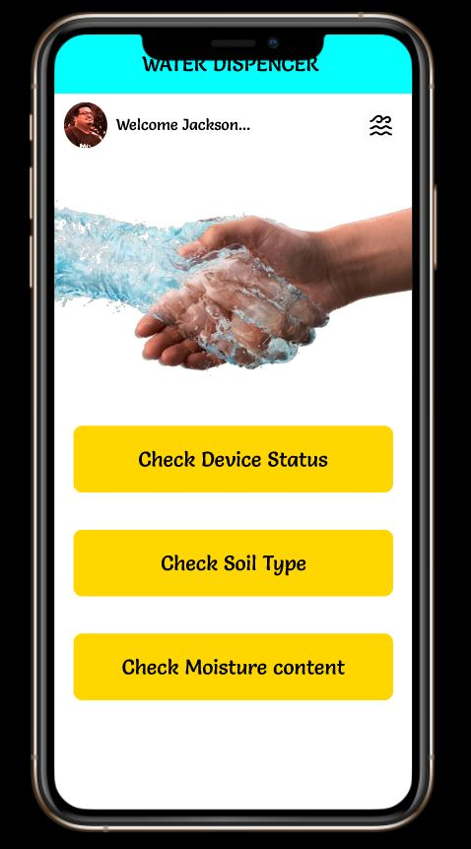
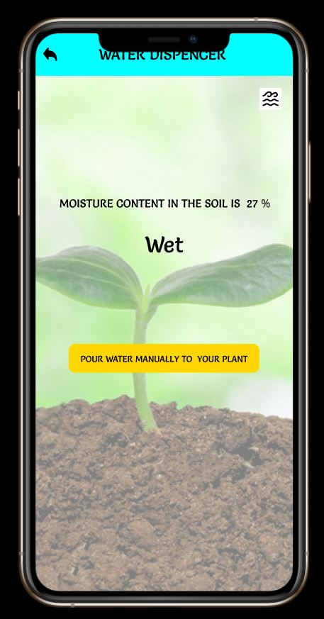
Sample

Slide 7
BLOCK DIAGRAM
VERIFY THROUGH OTP
SET MINIMUM MOISTURE LEVEL
MOBILE APP
CONNECT TO DEVICE
NOTIFY
WATER AUTOMATICALLY
GET DETAILS OF SOIL

Slide 8
Future Scope
In this technological world people would like to spend their free time with the pleasant environment to keep them away from mental distractions, Stress, Depressions in work etc...
Often, they have no time to take care of plants and forget to water them . Due to this these plants get wilted.
To avoid these things, we can use this Automatic Water dispenser to water them on time and keep them healthy and happy.

Slide 9
CONCLUSION
This prototype can be used to dispense water at the right time by inputting the pre determined amount of moisture content.
The moisture level for different types of soils are adjustable and can be changed accordingly.
When the user gets a notification in his mobile phone he can water the plant or the device itself pours water accordingly.

Slide 10
Demo video
https://drive.google.com/file/d/10Ijxx9KmKw8zYRaCo69QkuiPuN5kf7Dl/view?usp=sharing
Prototype link: https://www.figma.com/proto/XrV9YytZ55awv0YjJwcWal/Pico-Zen-team-library?page-id=0%3A1&node-id=411%3A2&viewport=-442%2C254%2C0.17292332649230957&scaling=scale-down&starting-point-node-id=411%3A2

Slide 11
THANK YOU…

